Slide 1
Análise de sistemas
2ªEntrega
2019/2020

Slide 2
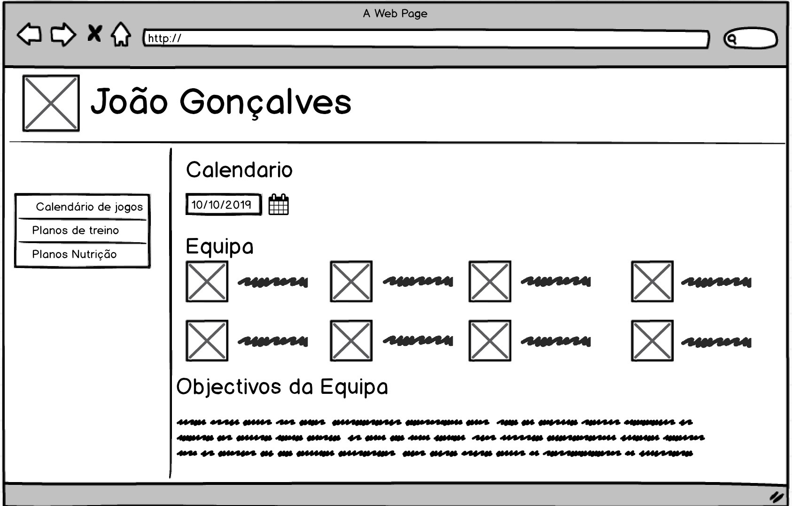
Mockup 01 <<Mod01/02/03>>

Slide 3
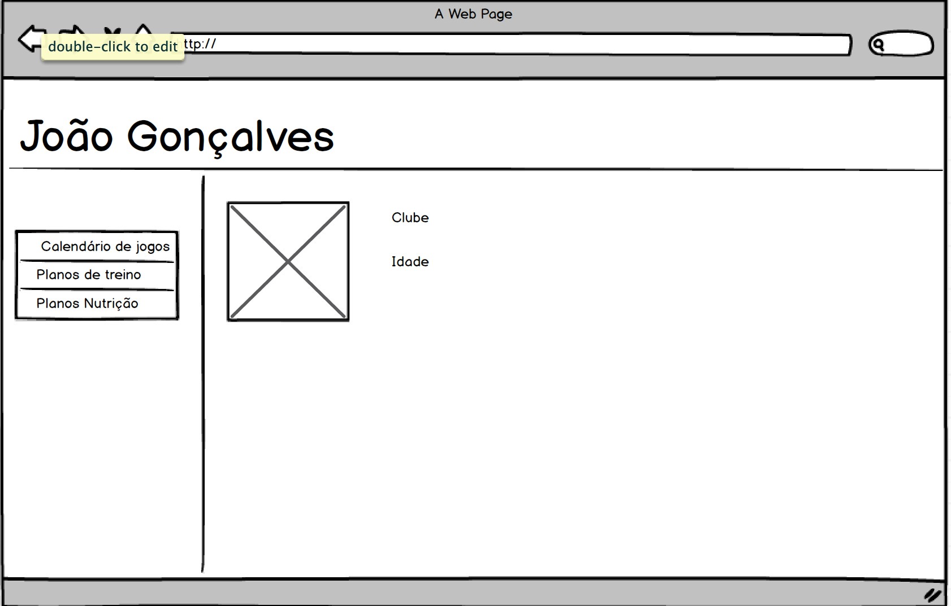
Mockup 02<<Mod02/03>>

Slide 4
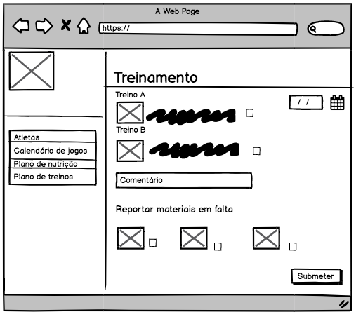
Mockup 03 <<Mod01>>

Slide 5
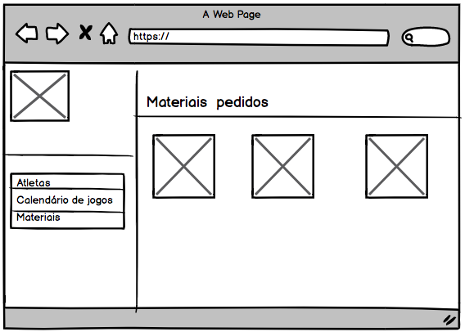
Mockup 04 <<Mod03>>

Slide 6
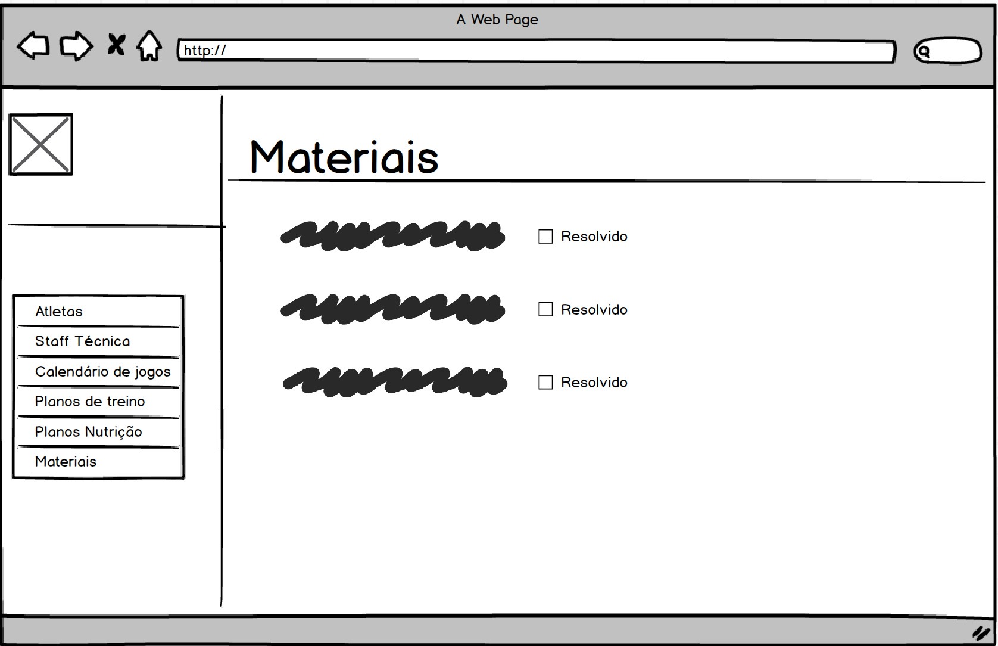
Mockup 05<<Mod03 >>

Slide 7
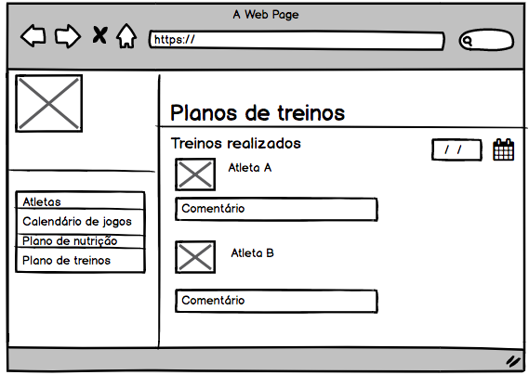
Mockup 06<<Mod02>>

Slide 8
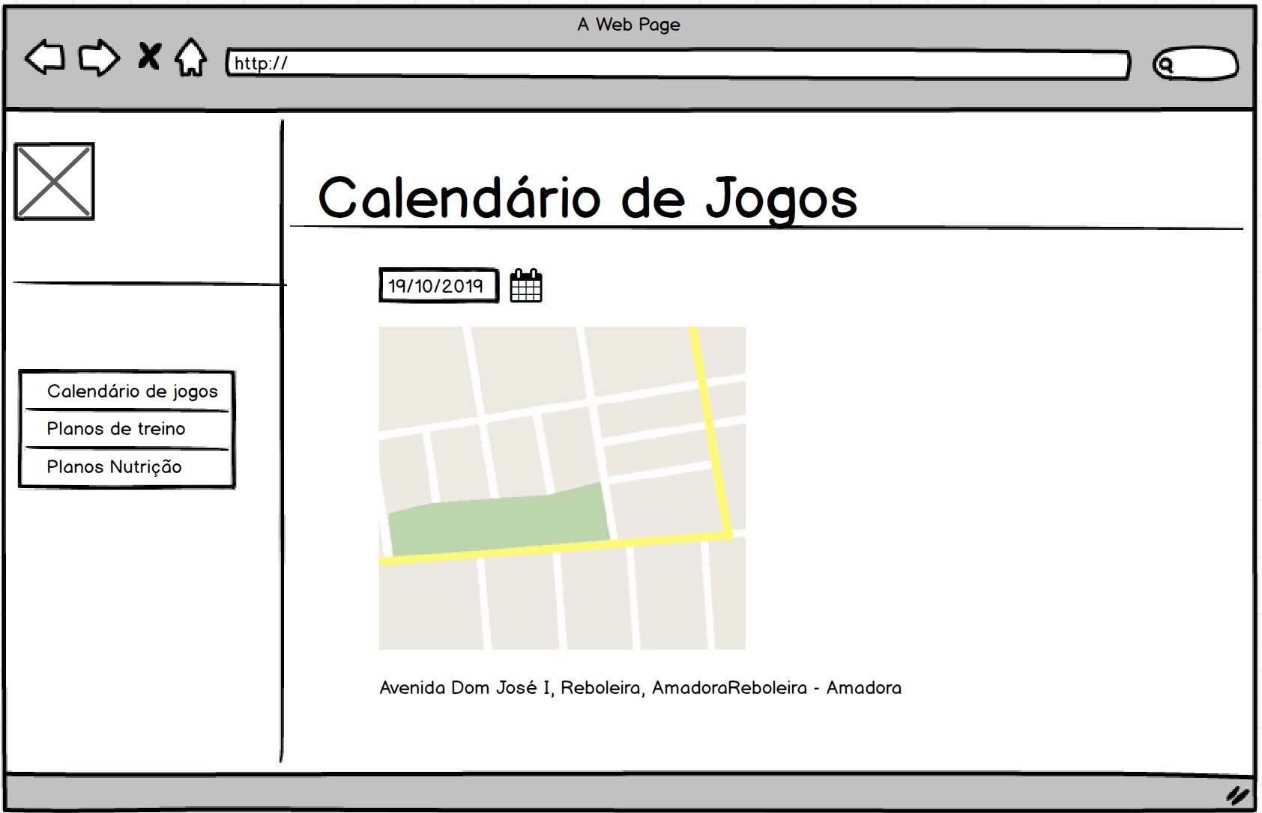
Mockup 07 <<Mod01/02/03>>

Slide 9
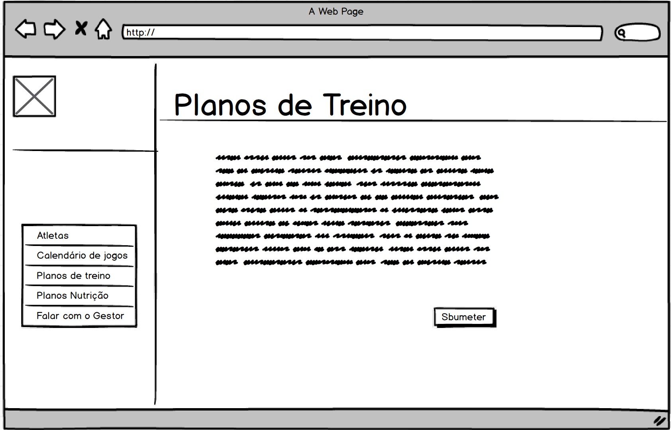
Mockup 08 <<Mod02>>

Slide 10
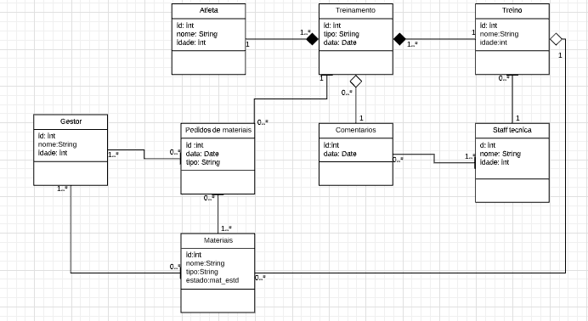
Modelo de Domínio

Slide 11


